Slide 1
Project Charter
A Project Charter is a first document that gets created , it is a high Level Project initiation formal Document.
Any Project cannot start without the project charter.
The project (initiator) or the project sponsor issues a Project Charter and it is owned by the project manager.

Slide 2
Contents of project charter
Project outline
Scope
Objectives and Constraints
Roles, Shareholders & project manager authority
Characteristics
Budget, milestones and risks
Project Requirements

Slide 3
Setting the research goal: Understanding the business or activity that our data science project is part of is key to ensuring its success and the first phase of any sound data analytics project. Defining the what, the why, and the how of our project in a project charter is the foremost task.
Now sit down to define a timeline and concrete
key performance indicators and this is the essential
first step to kick-start our data initiative!

Slide 4
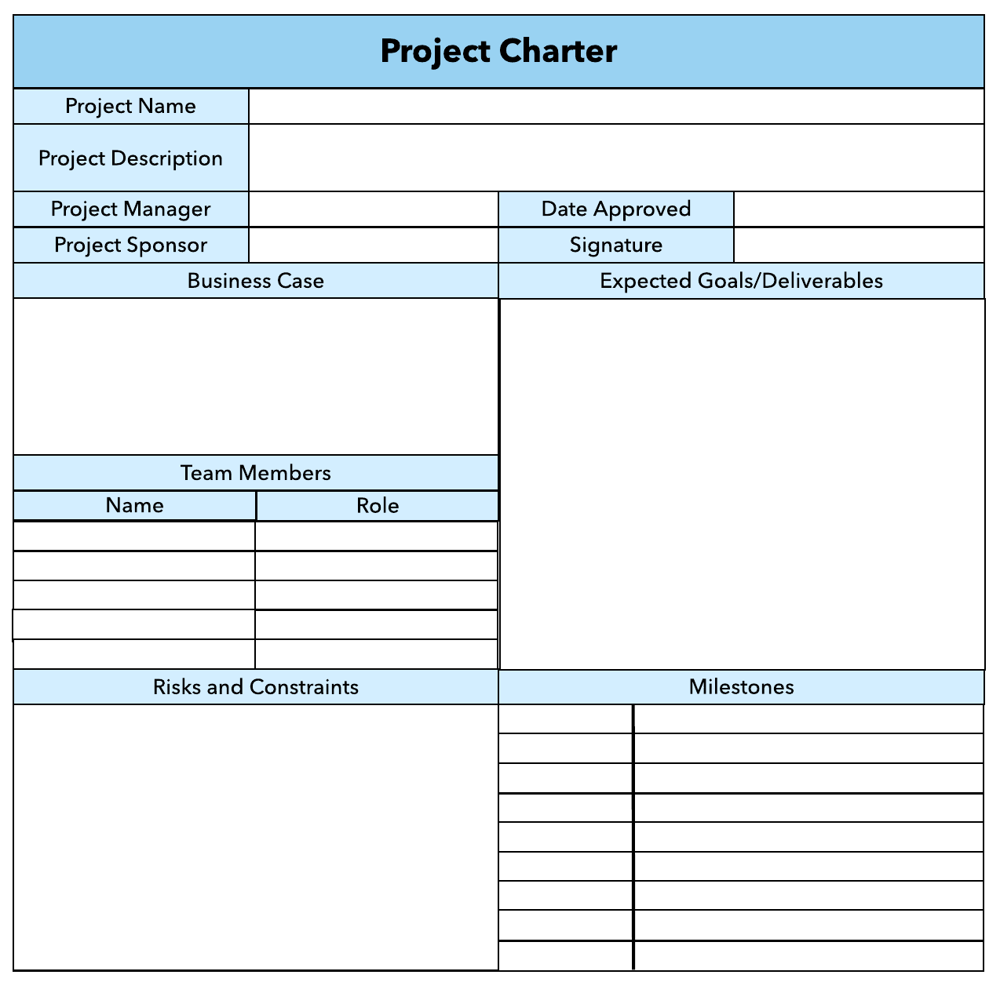
Example

Slide 5


Thank you

